Slide 1
House Price
Prediction
By,
Jofia Joe
Vandana Vijayan
Gana Shankarappa
Sanjo Antony M

Slide 2
INTRODUCTION
Demonstrates the usage of machine learning algorithms in the prediction of Real estate/House prices in Bangalore.
Literature about research on machine learning prediction of house prices in India is extremely limited.
Use machine learning algorithms to implement this prediction engine for real-life usage by users.
Findings:
Different algorithms can drastically change accuracy.
A poor dataset can negatively affect the predictions.
Sufficient proof of what algorithm is best suitable for this task.

Slide 3
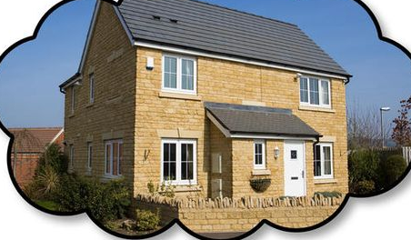
PROBLEM STATEMENT
People and real estate agencies buy or sell houses, people buy to live in or as an investment and the agencies buy to run a business.
Everyone should get exactly what they pay for.
Over-valuation/Under-valuation in housing markets has always been an issue
Lack of proper detection measures.
Primary aim - use Machine Learning Techniques and curate them into ML models which can then serve the users.

Slide 4
GAPS IN EXISTING SYSTEM
The present method is that the customer approaches a real estate agent to manage his/her investments and suggest suitable estates for his investments.
agents need to be paid a fraction of the amount just for searching a house and setting a price tag for you.
agents and sellers may have a secret dealing and the customer might be sold an overpriced house without his/her knowledge.
When people first think of buying a house/Real estate they tend to go online and try to study trends and other related stuff.
doesn’t have detailed knowledge & accurate information about what the actual price should be.
misinformation about the prices in the internet.
comparing it with multiple estates is highly time-consuming and has a potential risk of incorrect pricing.

Slide 5
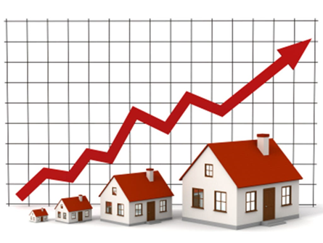
GOAL
The main aim of this project is to foresee house costs in Bengaluru city in view of certain elements like area, size/region, number of rooms, and number of washrooms.
Bengaluru house price dataset is utilized to create the model.
We have tried using a few machine learning algorithms in order to find out the best one which can give us the most accurate results .

Slide 6
TOOLS AND TECHNOLOGIES USED
Python
Numpy and Pandas for Data Cleaning
Matplotlib for Data Visualization
Sklearn for Model Building
Jupyter Notebook as IDE

Slide 7
STEPS
Data Collection
Data Cleaning
Feature Engineering
Dimensionality Reduction
Outlier Detection and Removal
Model Building
Model Testing

Slide 8
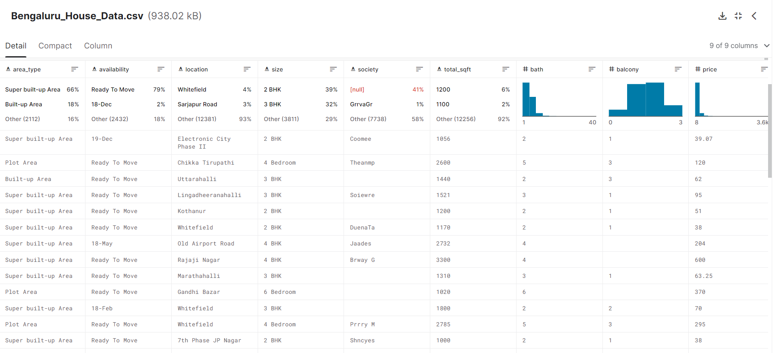
IMPORTING DATASET
The dataset was downloaded from here : : https://www.kaggle.com/amitabhajoy/bengaluru-house-price-data

Slide 9
ATTRIBUTES IN DATASET
Area_type
Availability
Location
Size
Society
Total_sqft
Bath
Balcony
Price

Slide 10
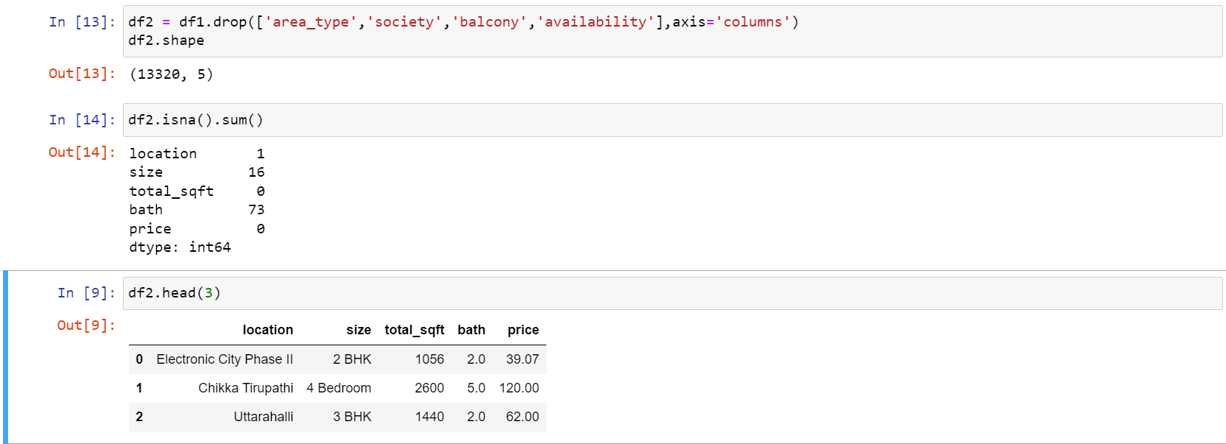
2. DATA CLEANING
Drop features that are not required to build our model.
b) Handle NA values.
Area_type
Society
Balcony
Availability

Slide 11
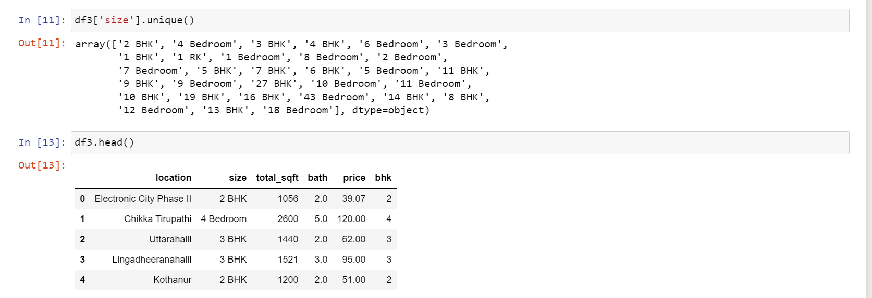
3. FEATURE ENGINEERING
Add new feature (integer) for bhk (bedroom hall kitchen)

Slide 12
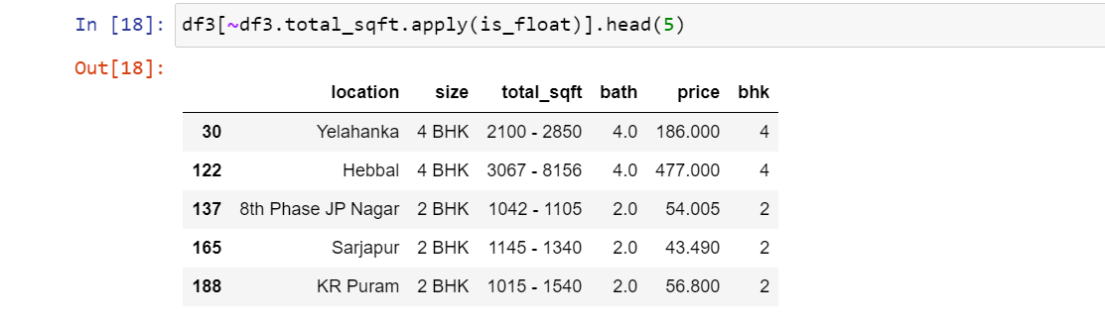
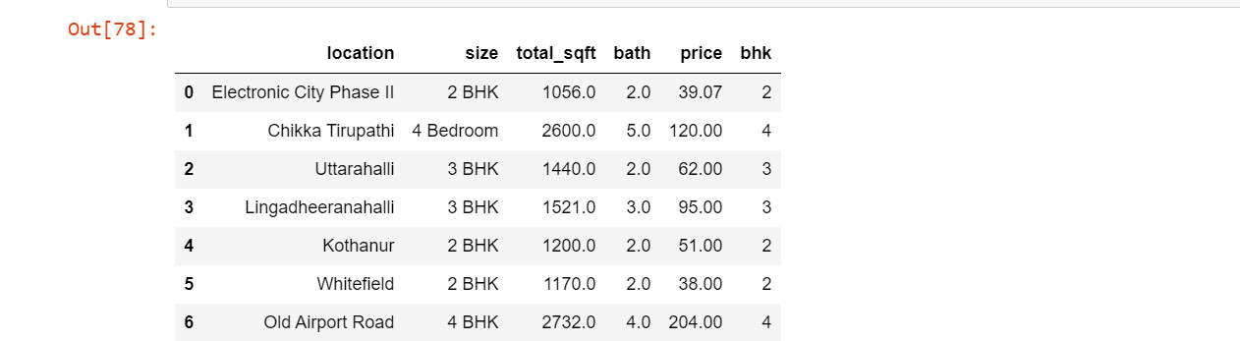
b) Explore and transform total_sqft feature

Slide 13
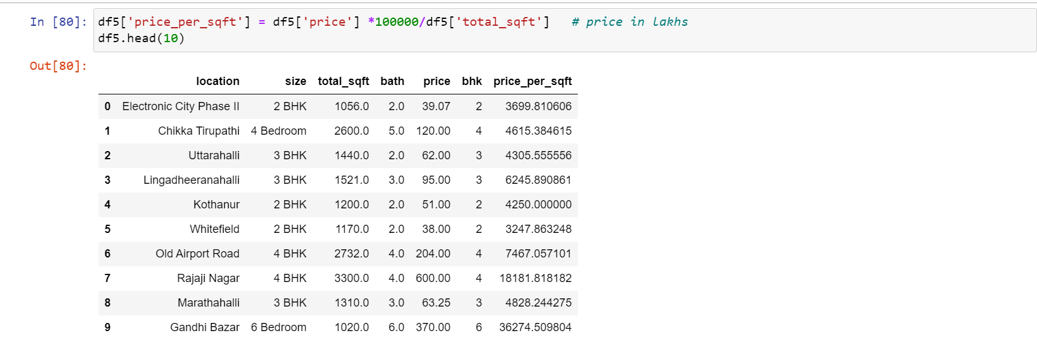
c) Add new feature price_per_sqft

Slide 14
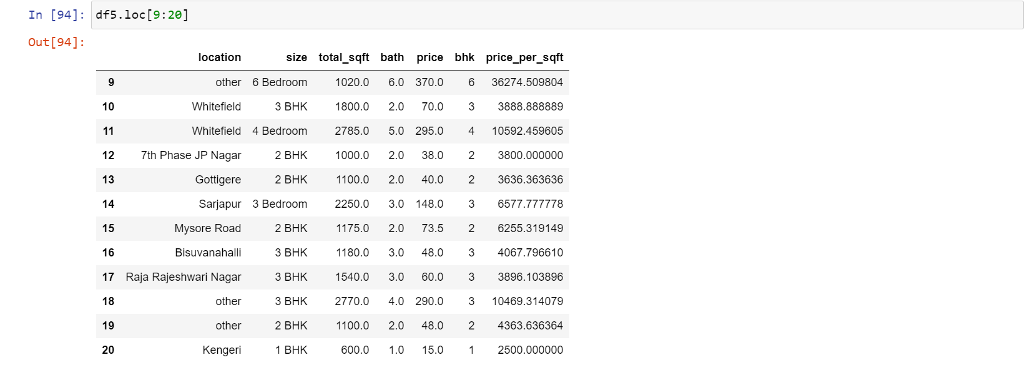
4. DIMENSIONALITY REDUCTION
Dimensionality reduction is a machine learning (ML) or statistical technique of reducing the amount of random variables in a problem by obtaining a set of principal variables.
Changed the name of the locations having less than 10 apartments in that area into “other” category.

Slide 15
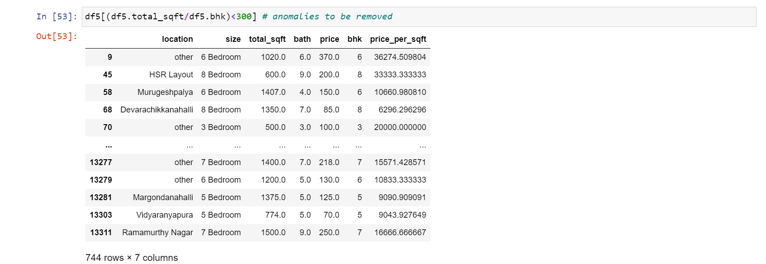
5. OUTLIER REMOVAL
An outlier is an value that lies far away from all other values in a given dataset.
Presence of outliers can lead to inconsistencies and further errors in results obtained so it is necessary to remove outliers
By keeping minimum threshold per bhk to be 300 sqft.

Slide 16
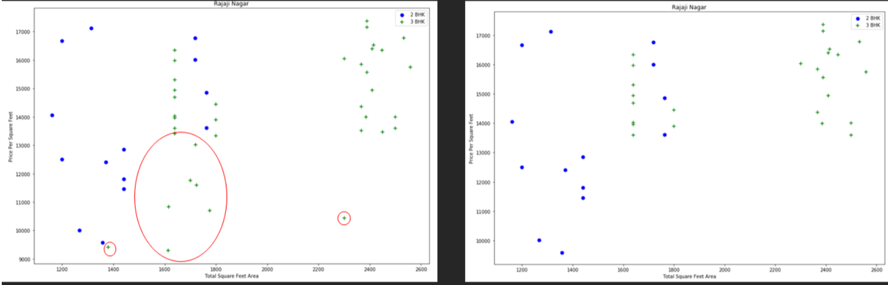
5. OUTLIER REMOVAL
Based on price per sqft.
Removed properties where for same location, the price of (for example) 3 bedroom apartment is less than 2 bedroom apartment (with same square ft area).

Slide 17
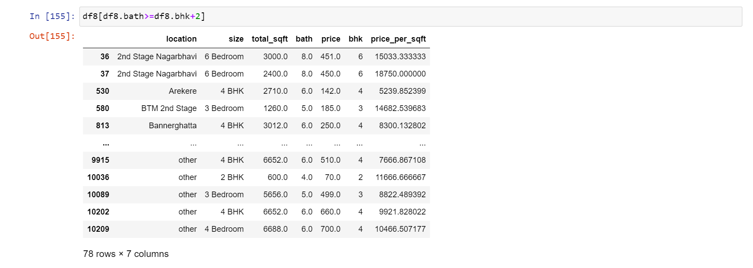
5. OUTLIER REMOVAL
Using bathroom feature.
Here I am considering, if you have 4 bedroom home and even if you have bathroom in all 4 rooms plus one guest bathroom, you will have total bath = total bed + 1 max. Anything above that is an outlier or a data error and can be removed.

Slide 18
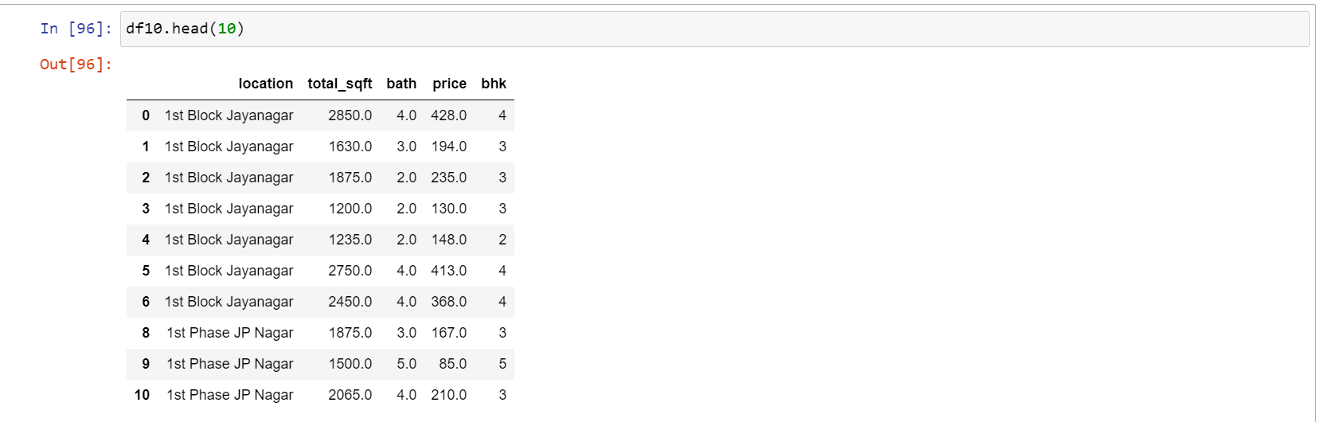
Columns - “size” and “price_per_sqft” are dropped and the dataset is ready to be trained.
After removing all outlier dataset has 7251 rows and 5 columns.

Slide 19
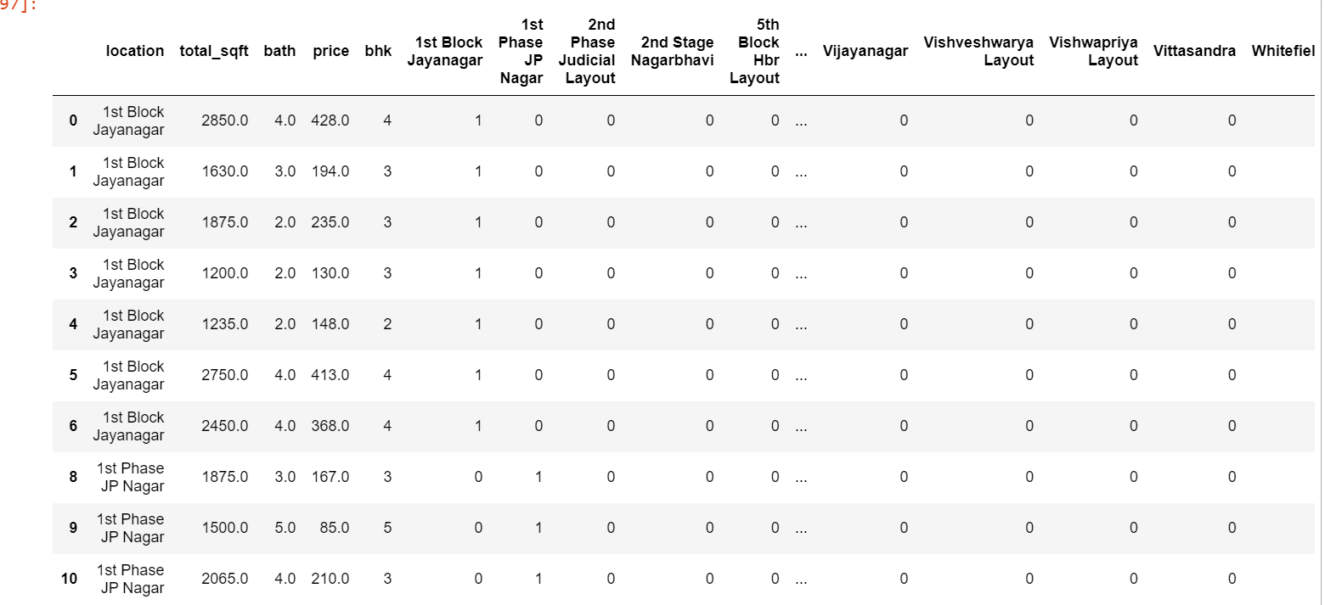
6. ONE HOT ENCODING FOR LOCATION

Slide 20
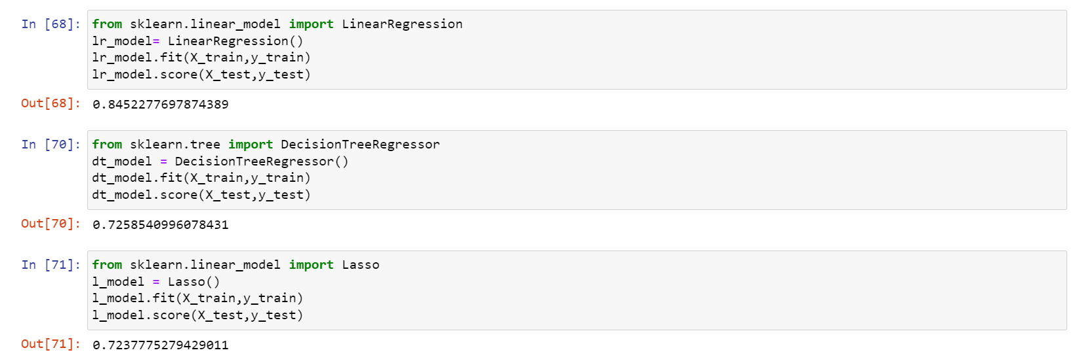
7. MODEL BUILDING
We used 3 machine learning algorithms to predict the prices of houses namely Linear Regression,Decision Tree and Lasso
However Linear Regression gave the best results. Hence it is used.

Slide 21
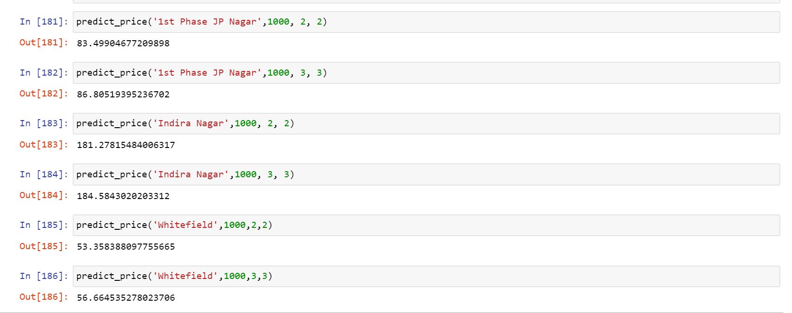
8. TEST THE MODEL
The model is used to predict prices for few properties.
predict_price(location, sqft, bath, bhk)

Slide 22
RESULTS
Although we used different algorithms for house price prediction Linear Regression was found to be the best algorithm as linear regression was able to give the best model score of 84.5% .
Linear Regression | 84.5%
Decision Tree Classifier | 71.7%
Lasso | 72.3%

Slide 23
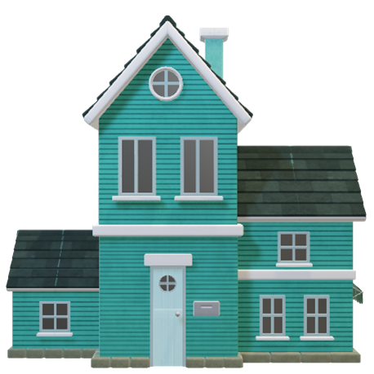
APPLICATIONS
Using this proposed model, we want people to buy houses and real estate at their rightful prices.
Ensure that they don't get tricked by sketchy agents who just are after their money.
Help Big companies by giving accurate predictions for them to set the pricing.
Save them from a lot of hassle and save a lot of precious time and money.
Correct real estate prices are the essence of the market and we want to ensure that by using this model.
Likewise, house price predictions are also beneficial for property investors to know the pattern of lodging costs in a specific area.

Slide 24
THANK YOU

